Slide 1
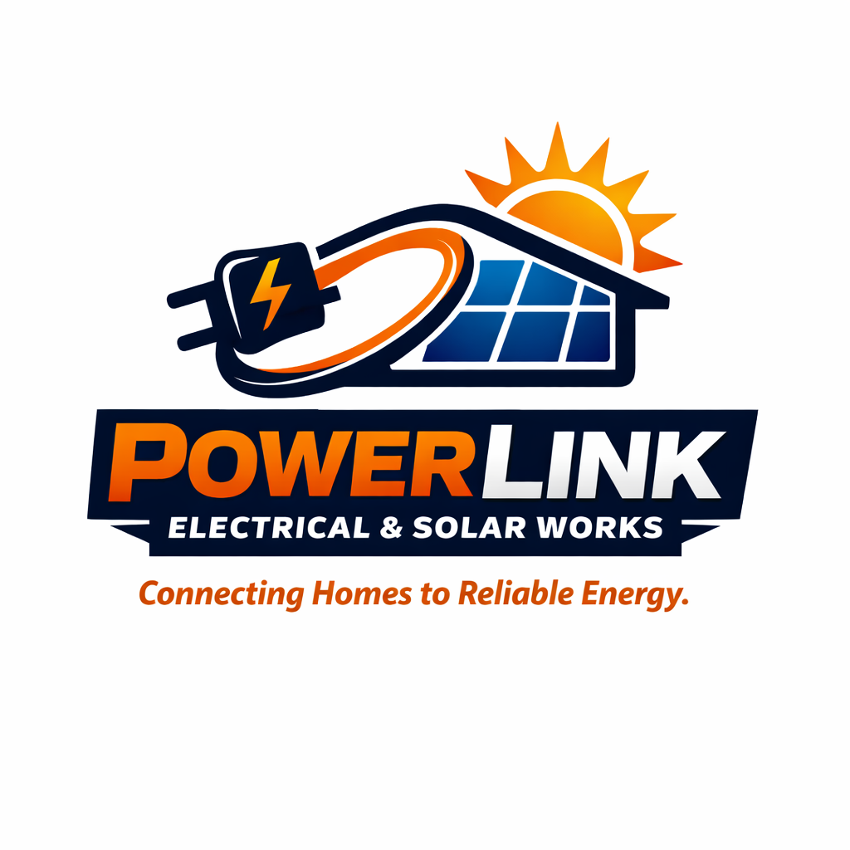

Slide 2
POWERLINK
Company Profile and Business Potential.
Connecting Homes to Reliable Energy!

Slide 3
POWERLINK COMPANY PROFILE.
1. Company Description
Company Name: Powerlink
Location: Juba, Central Equatoria, South Sudan
Founded: 10th/May/2026
Industry: Electrical and Solar works (Electrical Engineering, Renewable Energy & Technical Services)

Slide 4
About Us:
PowerLink Electrical & Solar Works is a proudly South Sudanese company dedicated to delivering safe, reliable, and professional electrical and solar energy solutions. Established in 2026, our company was founded with a vision to restore confidence in local expertise by providing services that meet high standards of quality, safety, and professionalism.
We serve residential homes, commercial buildings, offices, schools, churches, industries, NGOs, and government institutions. Through innovation, integrity, and customer satisfaction, PowerLink aims to become one of South Sudan's leading engineering companies while contributing to national development and sustainable energy access.

Slide 5
2.Our Vision
To become South Sudan's most trusted and innovative engineering company, delivering world-class electrical, renewable energy, and technological solutions that transform lives and power national development.
"Powering Progress. Inspiring Innovation. Building the Future."

Slide 6
3. Mission
Our mission is to provide safe, professional, affordable, and reliable electrical and renewable energy solutions while creating lasting value for our customers through excellence, integrity, innovation, and exceptional customer service.
We are committed to restoring trust in South Sudanese engineering by delivering quality workmanship that meets international standards.

Slide 7
4. Core Services
⚡ Electrical Wiring, Installation & Repairs
Professional electrical installation for residential, commercial, and industrial buildings. We provide new wiring, renovations, troubleshooting, fault diagnosis, repairs, upgrades, and preventive maintenance using safe and modern installation practices.
Our Promise: "Safe Wiring Today, Reliable Power Tomorrow."

Slide 8
☀️ Solar Power, Inverter & Battery Systems
We design and install complete solar energy systems including solar panels, batteries, inverters, charge controllers, and backup power systems that reduce dependence on unreliable electricity.
Our Promise: "Harnessing the Sun for a Brighter Tomorrow."

Slide 9
❄️ AC Installation, Service & Gas Refilling
Professional installation, servicing, maintenance, fault diagnosis, and refrigerant gas refilling for air conditioning systems to ensure comfort, efficiency, and long equipment life.
Our Promise: "Cooling Homes. Improving Comfort."

Slide 10
📹 CCTV Cameras & Surveillance Systems
Installation and maintenance of high-quality CCTV systems for homes, businesses, schools, offices, warehouses, and institutions to improve security and peace of mind.
Our Promise: "Protecting What Matters Most."

Slide 11
📡 Satellite TV, MultiTV Setup & Dish Alignment
Installation, alignment, repairs, and maintenance of satellite television systems including MultiTV, DStv, Free-to-Air, and dish realignment for clear signal reception.
Our Promise: "Crystal Clear Entertainment, Every Time."

Slide 12
🏠 House Wiring (New Construction & Renovation)
Complete electrical wiring solutions for newly constructed buildings and renovation projects, ensuring safe and organized installations that comply with professional standards.
Our Promise: "Building Safer Homes from the Ground Up."

Slide 13
🔌 DB Boards, Lightning Arresters, Earthing & JEDCO Connection
Installation of distribution boards, protective devices, lightning protection systems, grounding (earthing), and professional JEDCO electrical connections for enhanced safety.
Our Promise: "Protection Begins with Proper Installation."

Slide 14
🛠️ Maintenance, Conduit Slapping & Piping
Professional conduit installation, wall slapping, PVC piping, cable routing, electrical maintenance, and preventive servicing for residential and commercial projects.
Our Promise: "Strong Foundations for Reliable Power."

Slide 15
⚡ Electric Fence Installation & Security Systems
PowerLink provides professional electric fence installation, maintenance, fault finding, and system upgrades for homes, businesses, institutions, warehouses, compounds, and other properties.
Our solutions are designed to create an additional security layer around properties while emphasizing proper installation, responsible operation, and reliable system performance.
Our Promise:
"Stronger Boundaries. Greater Security. Peace of Mind."

Slide 16
5. Why Choose Powerlink
✅ Qualified and dedicated technicians
✅ Commitment to safety and quality workmanship
✅ Honest pricing with professional service
✅ Reliable after-service support
✅ Modern tools and innovative solutions
✅ Customer satisfaction is our priority
✅ Proudly South Sudanese with global standards
PowerLink Promise
"We Don't Just Install Electricity—We Build Trust."

Slide 17
Our Potential and Opportunities
PowerLink is more than an electrical company.
Our long-term vision is to grow into a diversified engineering and technology group that creates employment, promotes innovation, and contributes to the economic development of South Sudan.

Slide 18
1. ⚙️ POWERLINK FABRICATION
(Welding & Metal Engineering)
This division will specialize in steel fabrication, welding, gates, windows, security doors, roofing structures, tanks, trailers, metal furniture, industrial structures, and custom engineering projects.
Vision
To become South Sudan's leading fabrication company known for strength, precision, and engineering excellence.
Motto
"Forging Strength. Building the Future."

Slide 19
2. 🛒 POWERLINK ELECTROMART & SERVICES
(Electronics & Home Appliances)
A modern retail and repair center offering electrical materials, electronics, home appliances, solar products, power tools, accessories, installation, maintenance, and technical support.
Vision
To become South Sudan's most trusted destination for quality electrical and electronic products.
Motto
"Quality Products. Reliable Service."

Slide 20
3. 💻 POWERCODE TECH SOLUTIONS
(Technology & Digital Innovation)
A technology company specializing in:
• Software Development
• Mobile Applications
• Website Development
• Graphic Design
• Branding
• Digital Marketing
• Printing Services
• Computer Networking
• ICT Consultancy
• Artificial Intelligence Solutions

Slide 21
Vision
To empower Africa through innovative technology that transforms businesses and communities.
Motto
"Coding the Future. Designing Innovation."

Slide 22
4. 🌱 PowerLink Environmental Innovation
Environmental Innovation is the development and application of innovative, practical, and sustainable solutions to environmental and community problems. This includes using IoT-powered sensors to automatically trigger water pumps for irrigating plants growing between opposite roads, providing solar-powered water pumps to help communities access water, and developing many other technology-based solutions that protect the environment, conserve resources, and improve communities.
Motto
“Innovating Solutions for a Greener and Sustainable Future.”
Vision
To create a greener, smarter, and more sustainable South Sudan where innovation, technology, and renewable energy are used to solve environmental challenges, improve access to essential resources, and build better communities for present and future generations. 🇸🇸🌱☀️💧

Slide 23
5. 💧 POWERLINK AQUAENERGY
(Hydroelectric Power)
Development of hydroelectric power projects, mini-hydropower stations, water pumping systems, irrigation solutions, and renewable energy infrastructure to support national electrification.
Vision
To harness the power of water to provide clean, affordable, and sustainable electricity across South Sudan.
Motto
"Powering Nations Through Water."

Slide 24
💼 POWERLINK CAPITAL & ASSETS
Investment • Real Estate • Transportation • Strategic Assets
Vision
"Building Lasting Wealth Through Strategic Investments and Productive Assets."
Motto
"Invest Today. Build Assets. Create Tomorrow."

Slide 25
Opportunities
PowerLink has significant opportunities to grow into one of South Sudan's leading engineering and technology companies by:
Expanding renewable energy solutions as demand for solar power increases.
Partnering with NGOs, government institutions, schools, hospitals, and private companies on infrastructure projects.
Creating jobs by training and employing skilled South Sudanese technicians and engineers.

Slide 26
Opening branches in all states of South Sudan and eventually expanding into neighboring East African countries.
Establishing an engineering training academy to develop the next generation of electricians, solar technicians, and technology professionals.
Becoming a trusted supplier of electrical materials, solar equipment, and smart energy solutions.
Driving digital transformation through PowerCode Tech Solutions by providing software, websites, and ICT services.

Slide 27
Contributing to environmental protection through clean energy, recycling initiatives, and sustainable engineering.
Investing in hydroelectric and other renewable energy projects to strengthen South Sudan's energy independence.
Building a strong brand recognized for professionalism, innovation, integrity, safety, and excellence.

Slide 28
Potential structure
POWERLINK GROUP │
PowerLink can eventually develop from an electrical and solar company into a diversified South Sudanese engineering, technology, energy, and investment group.
├── ⚡ PowerLink Electrical & Solar Works
├── ⚙️ PowerLink Fabrication
├── 🛒 PowerLink ElectroMart & Services
├── 💻 PowerCode Tech Solutions
├── 🌱 Environmental Innovation
├── 💧 PowerLink AquaEnergy
└── 💼 PowerLink Capital & Assets

Slide 29
PowerLink Group Long-Term Vision
To be South Sudan’s leading integrated energy and technology group —
powering homes, industries, and innovation across every state.
"POWERING PROGRESS. BUILDING ASSETS. CREATING THE FUTURE."

